Slide 1
More than activities
Università di Modena e Reggio Emilia

Slide 2
Log message
Android provide Log class, which allows you to create log messages. Messages appear in Android Studio's Logcat during app execution and make easier app debug.
Exist 5 priority level:
Log.e(String TAG, String message) -> error
Log.w(String TAG, String message) -> warning
Log.i(String TAG, String message) -> information
Log.d(String TAG, String message) -> debug
Log.v(String TAG, String message) -> verbose
In Logcat appear massage like:
date time PID-TID/package priority/tag: message
https://developer.android.com/studio/debug/am-logcat

Slide 3
fragment

Slide 4
What is Fragment?
A fragment enable you to divide Activities into encapsulated and reusable components.
Defines and manages its own layout, has its own lifecycle, and can handle its own input events.
Fragments cannot live on their own--they must be hosted by an activity or another fragment. The fragment’s view hierarchy becomes part of, or attaches to, the host’s view hierarchy.
Fragment can either contain UI or not, you can use Fragment to provide background behaviour that persists across Activity restart caused by configuration changes.

Slide 5
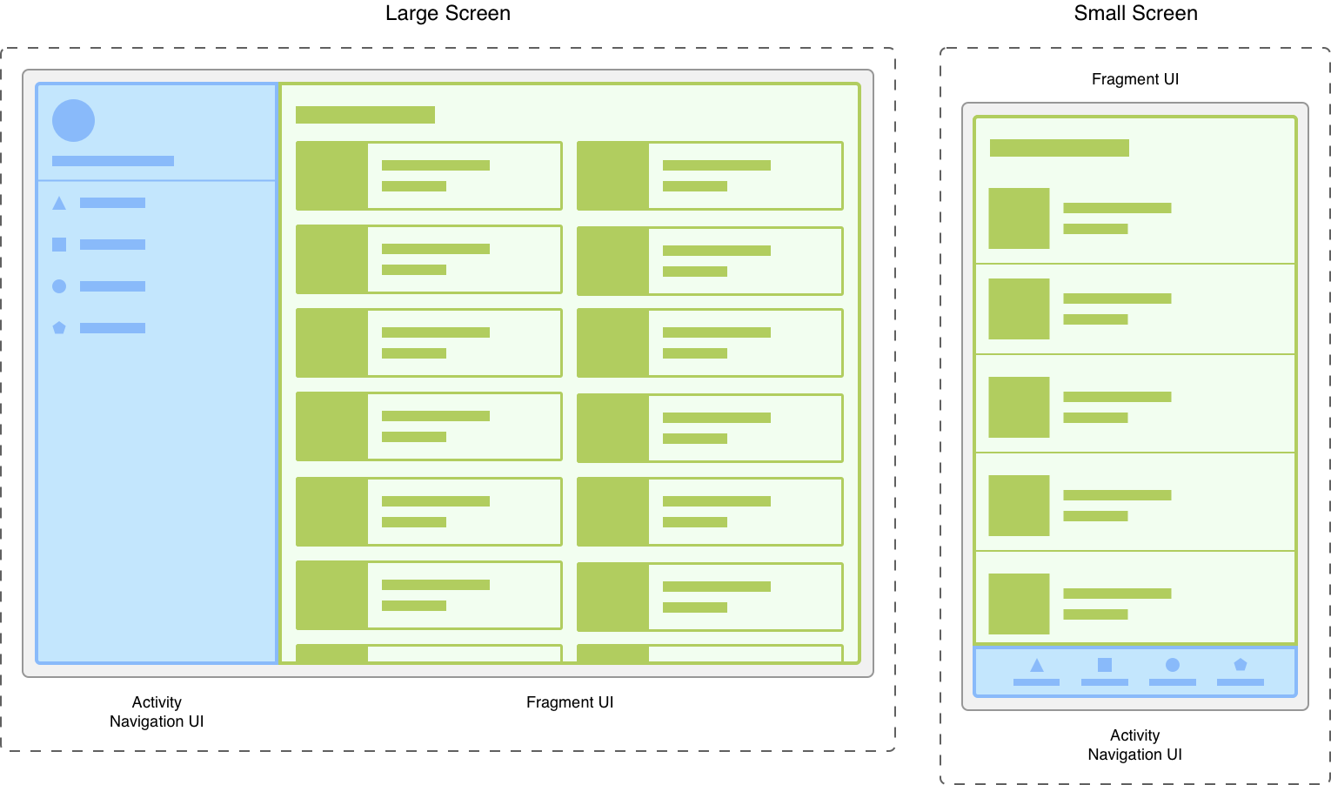
Why use fragments?
Modularity and reusability: fragments are independents module that is loosely coupled to the Activity into which it is added.
Dynamism of UI: you can attach, detach, replace fragments at runtime.
For this, if you inflate a layout to a Fragment, it MUST manage its own UI and avoid dependency.
========================================BEST PRACTISE: usually in app there is one or small number of activities, with each of them represents a group of related screens. Activity may provide a point to place top level navigation. Each individual destination should be represented by a fragment

Slide 6
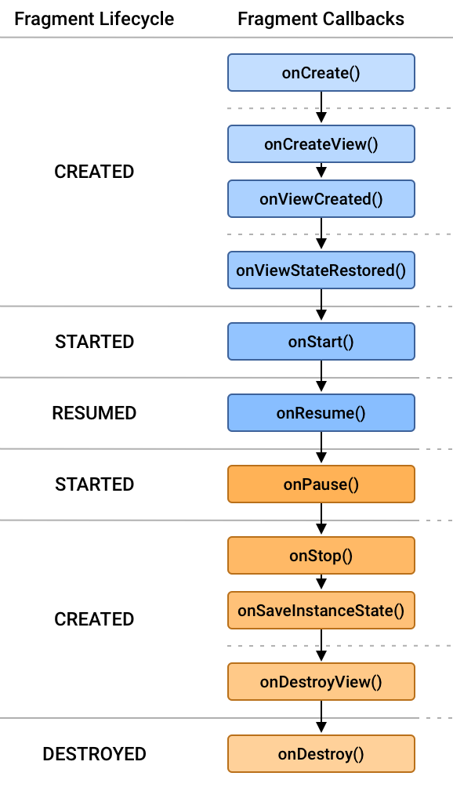
Fragment lifecycle
Each fragment instance has its own lifecycle.
A fragment's lifecycle state can never be greater than its parent. States are contained Lifecycle.State enum:
INITIALIZED: this state begin with fragment is instantiated before onAttach() execution is terminated
CREATED: it has been added to a FragmentManager and onAttach() has already been called. This transition invokes onCreate()
STARTED: onStart() is invoked
RESUME: fragment visible and ready for user interaction. onResume() is invoked
DESTROYED: fragment removed or if FragmentManager is destroyed, onDestroy() is invoked

Slide 7
Fragment class methods
public class Fragment {
// CONSTRUCTORS
public Fragment(@LayoutRes int id)
public Fragment()
// MANAGE FRAGMENT LIFECYCLE AND FRAGMENT'S VIEW
public void onAttach(@NonNull Context context)
public void onCreate(@Nullable Bundle savedInstanceState)
public @Nullable View onCreateView( @NonNull LayoutInflater inflater,
@Nullable ViewGroup container,
@Nullable Bundle savedInstanceState )
public void onViewCreated(@NonNull View view, @Nullable Bundle savedInstanceState)
public void onViewStateRestored(@Nullable Bundle savedInstanceState)
public void onStart()
public void onResume()
public void onPause()
public void onStop()
public void onDestroyView()
public void onDestroy()
public void onDetach()
public @Nullable View getView()
// SAVE AND RESTORE STATE
public void onSaveInstanceState(@NonNull Bundle outState)
} https://developer.android.com/reference/androidx/fragment/app/Fragment

Slide 8
Constructors
public Fragment()
Params: no params
Returns: empty fragment
Default constructor
public Fragment(@LayoutRes int id)
Params: layout to inflate to the Fragment
Returns: fragment which has already layout inflated

Slide 9
Manage lifecycle and view
public void onAttach(@NonNull Context context)
Params: context of the activity in which fragmet will be attached
Is called only once when fragment is attached to its context
public void onCreate(@Nullable Bundle savedInstanceState)
Params: Bundle: If non-null, this fragment is being re-constructed from a previous saved state as given here.
Used to initialize the fragment

Slide 10
Manage lifecycle and view
public View onCreateView(LayoutInflater, ViewGroup, Bundle)
Params:
LayoutInflater: The LayoutInflater object that can be used to inflate any views in the fragment,
ViewGroup: If non-null, this is the parent view that the fragment's UI should be attached to. The fragment should not add the view itself, but this can be used to generate the LayoutParams of the view.
Bundle: If non-null, this fragment is being re-constructed from a previous saved state as given here.
Returns: Return the View for the fragment's UI, or null.
Called to have the fragment instantiate its user interface view. This is optional, and non-graphical fragments can return null. This will be called between onCreate() and onViewCreated().
public void onViewCreated(View, Bundle)
Params:
View is the root hierarchy (non null)
Bundle: is the same bundle passed to onCreate
It is invoked a the end of onCreateView()
Here you can setup views (add listener ecc.)
public void onViewStateRestored(Bundle)
Params: Bundle: is the same bundle passed to onCreate
Called when all saved state has been restored into the view hierarchy of the fragment. This can be used to do initialization based on saved state that you are letting the view hierarchy track itself, such as whether check box widgets are currently checked.

Slide 11
Manage lifecycle and view
public void onStart()
is called once the fragment is ready to be displayed on screen. At the end of this Fragment become visible
public void onResume()
At the end of execution, Fragment become in foreground
Allocate “expensive” resources.
public void onPause()
is called when fragment is no longer in foreground.
Release “expensive” resources. Commit any changes.
public void onStop()
is called when fragment is no longer visible; at the end of execution, fragment enters stopped state.

Slide 12
Manage lifecycle and view
public void onDestroyView()
Called when the view previously created by onCreateView() has been detached from the fragment. The next time the fragment needs to be displayed, a new view will be created.
public void onDestroy()
called to do final clean up of the fragment's state
public void onDetach()
is invoked when the fragment has been removed from a FragmentManager and is detached from its host activity. This is called after onDestroy()
public View getView()
Get the root view for the fragment's layout (the one returned by onCreateView), if provided.

Slide 13
Custom fragment

Slide 14
Creating fragment
After that you create your custom Fragment, you have load it to an activity.
FragmentActivity is the base class for AppCompatActivity which allow you to use Fragments in your custom Activity.
Add FragmentContainerView in layout file, that defines the location where the fragment should be placed within the activity's view hierarchy. <androidx.fragment.app.FragmentContainerView xmlns:android="http://schemas.android.com/apk/res/android" android:id="@+id/fragment_container_view" android:layout_width="match_parent" android:layout_height="match_parent"/>

Slide 15
Creating fragment
Add specific Fragment
In activity's xml file, add the following line:
android:name="com.example.ExampleFragment"
Programmatically, in activity's onCreate() method, using FragmentManager and FragmentTransaction

Slide 16
FragmentManager
Is the class responsible for performing actions on your app' fragments (adding, removing, replacing them), managing fragment back stack (stack of previous fragments which have been displayed to the user)
Access the FragmentManager
In activity: using getSupportFragmentManager() (AppCompatActivity's method)
In fragment: using getChildFragmentManager() in parent fragment or getParentFragmentManager() in child fragments

Slide 17
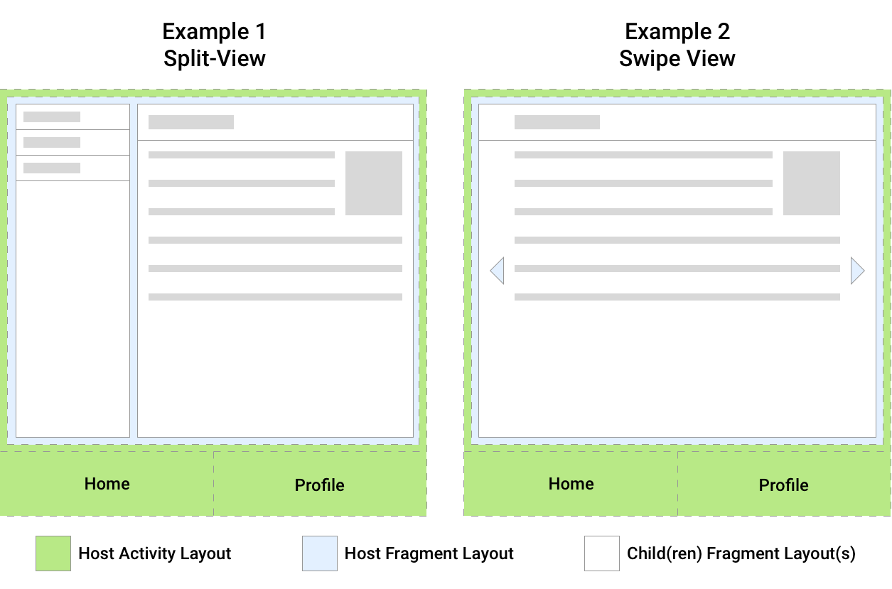
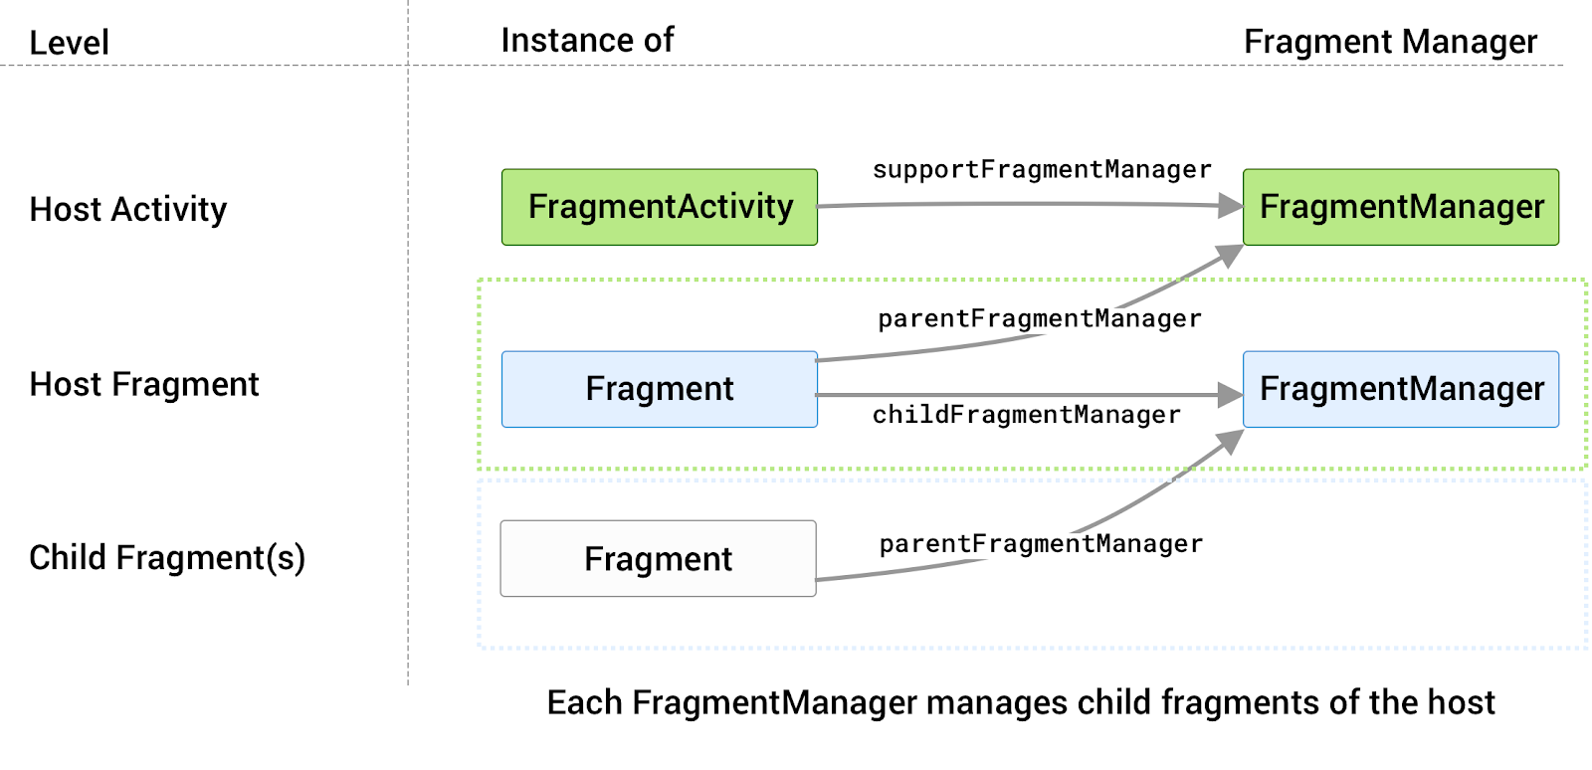
Access the FragmentManager

Slide 18
Using FragmentManager
FragmentManager methods:
Manage transaction
addToBackStack()
popBackStack()
beginTransaction()
Finding existing fragment
findFragmentById()
findFragmentByTag()

Slide 19
Find existing fragments
You can get a reference to fragments using FragmentManager methods:
Fragment findFragmentById(@IdRes int id)
Finds a fragment that was identified by the given id either when inflated from XML or as the container ID when added in a transaction.
Fragment findFragmentByTag(@Nullable String tag)
Finds a fragment that was identified by the given tag either when inflated from XML or as supplied when added in a transaction.

Slide 20
FragmentTransaction
Transactions are each set of fragment changes(e.g.: add, remove, replace operations) that you committed
Android provide the FragmentTrasation class.
FragmentTransaction is treated as a single atomic set of operations
Each transaction is sei in the Fragment back stack of FragmentManager
HOW TO USE TRANSACTIOJN?
//create fragment transaction
FragmentManager fragmentManager = ... FragmentTransaction transaction = fragmentManager.beginTransaction(); transaction.setReorderingAllowed(true);
//perform operation (add, replace, remove, …)
//specify animations
// add to back stack
//commit the transaction
transaction.commit();

Slide 21
FragmentTransaction methods
Each of following methods return the same FragmentTransactions instance, which has called the method.
commitNow()
commit()
add()
replace()
remove()
hide()
show()
attach()
detach()

Slide 22
Adding fragments
add()
used to add a fragment to a FragmentManager. add() method has been overloaded but all the signature has following common params:
@IdRes int containerViewId
Class<Fragment> FragmentClass
example [add(int id, Class<Fragment> fragmentClass, String tag)]
transaction.add(R.id.fragment_container,
ExampleFragment.class,
MY_FRAGMENT_TAG);

Slide 23
Removing fragments
remove()
used to remove a specific fragment to a FragmentManager
example [remove(Fragment fragment)]
//find a reference to a specify Fragment
Fragment frag = fragmentManager.findFragmentByTag(MY_FRAGMENT_TAG);
//remove fragment
fragmentTransiction.remove(frag);

Slide 24
Replacing fragments
replace()
used to replace a specific fragment with another one
example [replace(int id, Fragment frag, String tag)]
fragmentTransaction.replace(R.id.fragment_container,
new MyFragment(),
MY_FRAGMENT_TAG);

Slide 25
Hide and show fragments
hide()
used to hide the view of fragments that have been added to a container
example [hide(@NonNull Fragment fragment)]
fragmentTransition.hide(frag)
show()
Shows a previously hidden fragment. This is only relevant for fragments whose views have been added to a container, as this will cause the view to be shown.
example [show(@NonNull Fragment fragment)]
fragmentTransaction.show(frag);

Slide 26
Attach and detach fragments
detach()
used to detach fragment from the UI, it also detroyes fragment's vie hierarchy. The fragment remains in STOPPED state as when it is put on the back stack. This means that the fragment was removed from the UI but is still managed by the fragment manager.
attach()
used to reattach a fragment. This causes its view hierarchy to be recreated, attached to the UI, and displayed.

Slide 27
Resume
Add FragmentContainerView to Activity's Layout xml file
Create your custom Fragment
Bind your fragment with a layout resource
Manage fragments with FragmentManager and FragmetTransaction
use FragmentManager to find fragments and manage back stack
use FragmentTransaction to

Slide 28
Example

Slide 29
Communicate with fragment

Slide 30

FrameLayout
FrameLayout is designed to block out an area on the screen to display a single item.
Child views are drawn in a stack, with the most recently added child on top.
BEST PRACTISE: should be used to hold a single child view, because it can be difficult to organize views without overlapping.

Slide 31
VIEWMODEL

Slide 32
Introduction

Slide 33
ViewModel class

Slide 34
ViewModel class: methods

Slide 35
ViewModel example

Slide 36
permission

Slide 37
Permission
App permissions help support user privacy by protecting access to the following:
Restricted data, such as system state and a user's contact information.
Restricted actions, such as connecting to a paired device and recording audio
https://developer.android.com/reference/android/Manifest.permission

Slide 38
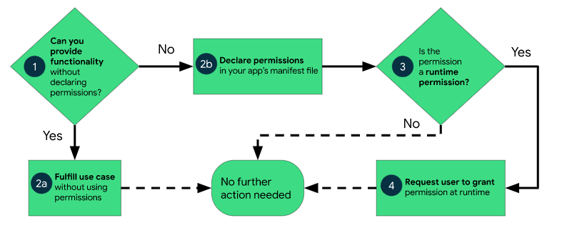
Workflow for using permission

